Slide 1
INT-217 INTRODUCTION TO DATA MANAGEMENT
ETP – DATA ANALYSIS AND DASHBOARD USING EXCEL
IPL DATASET (2008-2019)

Slide 2
Name : Pratik Suhag Registration No. : 11902729 Section :KM038
Course : Integrated B.Tech. (CSE) - MBA

Slide 3

SOURCE OF DATASET
Kaggle (IPL Dataset 2008-2019)
https://www.kaggle.com/ramjidoolla/ipl-data-set

Slide 4




INTRODUCTION TO MS-EXCEL
Microsoft Excel is a spreadsheet software by Microsoft.
It is an electronic spreadsheet with numerous rows and columns, used for organizing data, graphically represent data(s), and performing different calculations. It is also used for data manipulation, analysis, and visualization.
The first version was released in 1985 and has gone through several changes over the years. However, the main functionality mostly remains the same.
It consists of 1048576 rows and 16383 columns; a row and column together make a cell. Each cell has an address defined by column name and row number example A1, D2, etc. this is also known as a cell reference.
Excel provides us the worksheet to create a new document in it. You can save the Excel file with .xlsx or .xls extension.

Slide 5
FEATURES OF MS-EXCEL

Slide 6
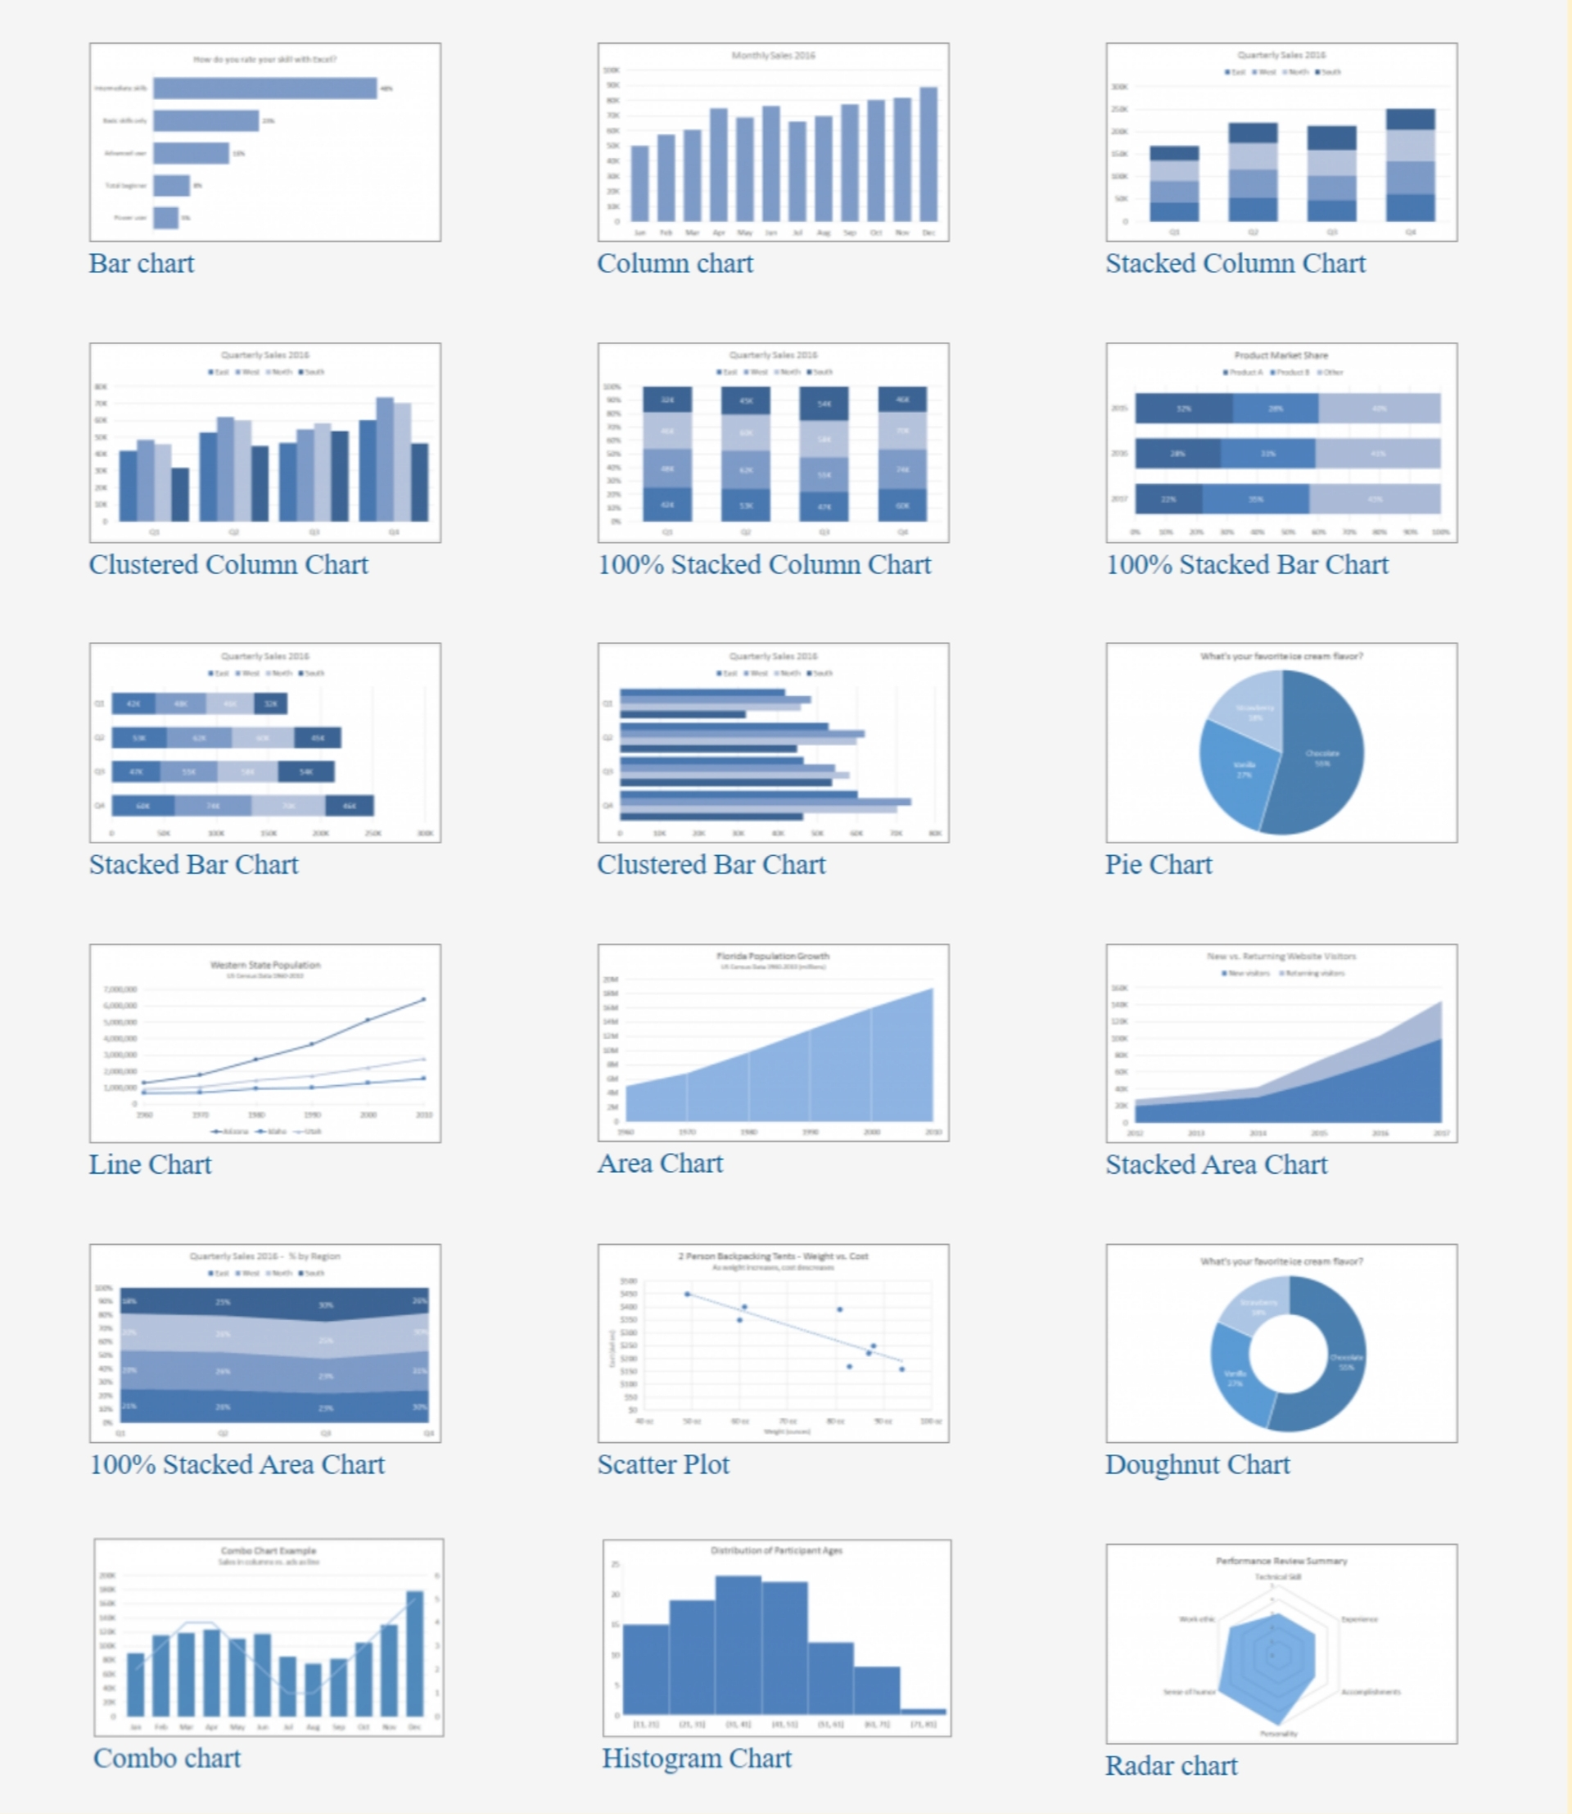
TYPES OF CHARTS IN MS-EXCEL

Slide 7
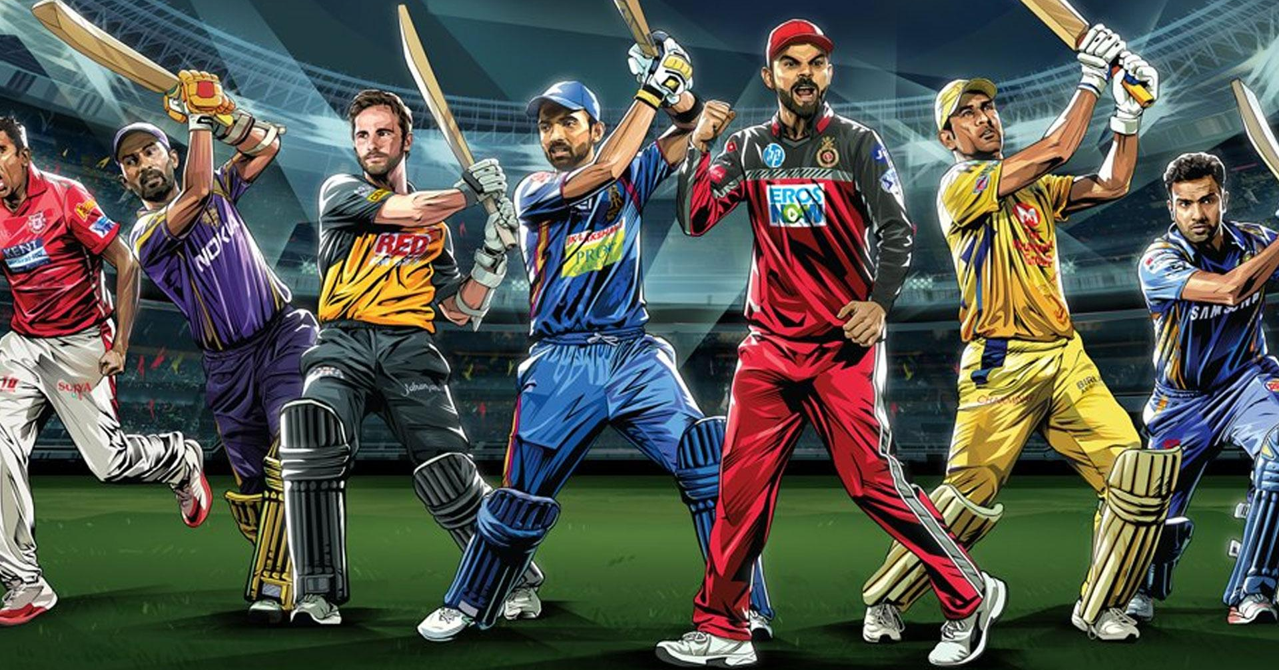
IPL DATASET (2008-2019)
The dataset includes statistics of IPL from 2008 to 2019.
The Indian Premier League (IPL) is a professional men's Twenty20 cricket league, contested by ten teams based out of ten Indian cities.
The league was founded by the Board of Control for Cricket in India (BCCI) in 2007. It is usually held between March and May of every year.
Its first season commenced on 18 April 2008.
IPL is not only for Indian cricketers. The format of IPL also allows the overseas players to participate in the tournament.
IPL brings RCB fans every season hoping “ E Sala Cup Namde”

Slide 8
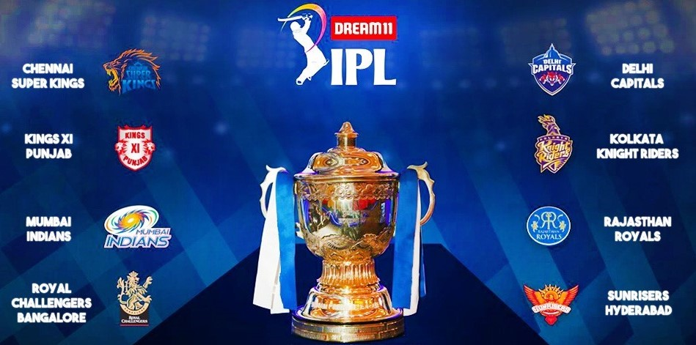
OBJECTIVES
Top 15 batsman of the IPL with their strike rate, average and number of times dismissed.
Analysis of Match win dependency on Toss win.
Analyze Total Runs scored in each over in IPL.
Analyze the Home and Away - Matches played and Matches won.
Total Matches Played and Won by each team.
Analyze Players on basis of their Country and Batting Type.

Slide 9
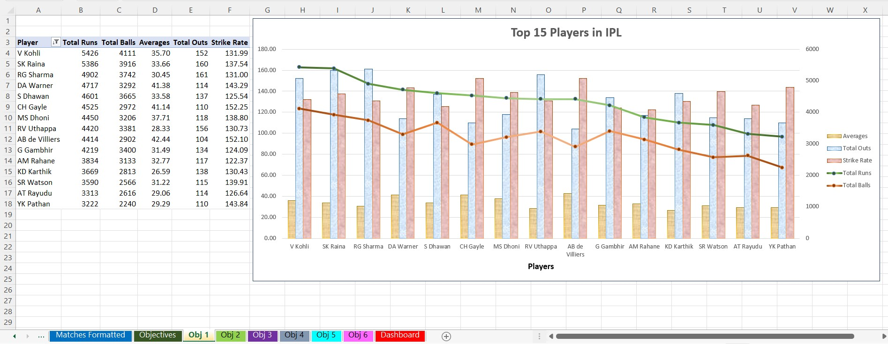
OBJECTIVE 1: Top 15 batsman of the IPL with their strike rate, average and number of times dismissed.

Slide 10
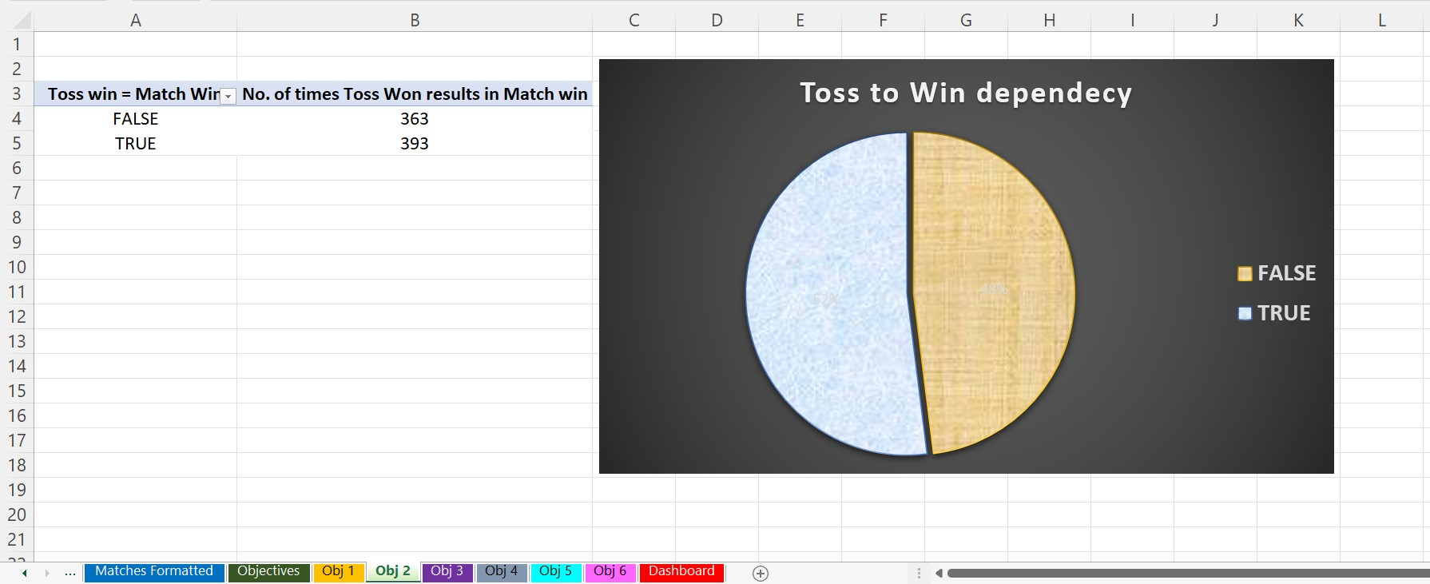
OBJECTIVE 2: Analysis of Match win dependency on Toss win.

Slide 11
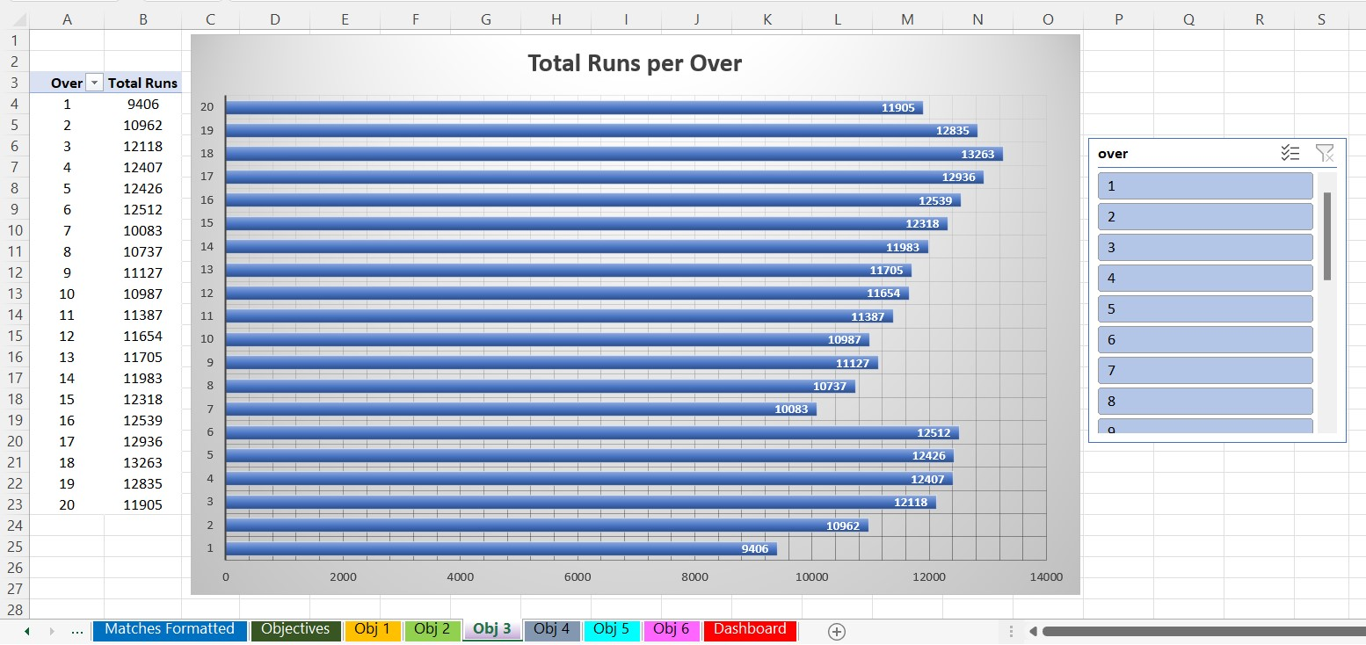
OBJECTIVE 3: Analyze Total Runs scored in each over in IPL.

Slide 12
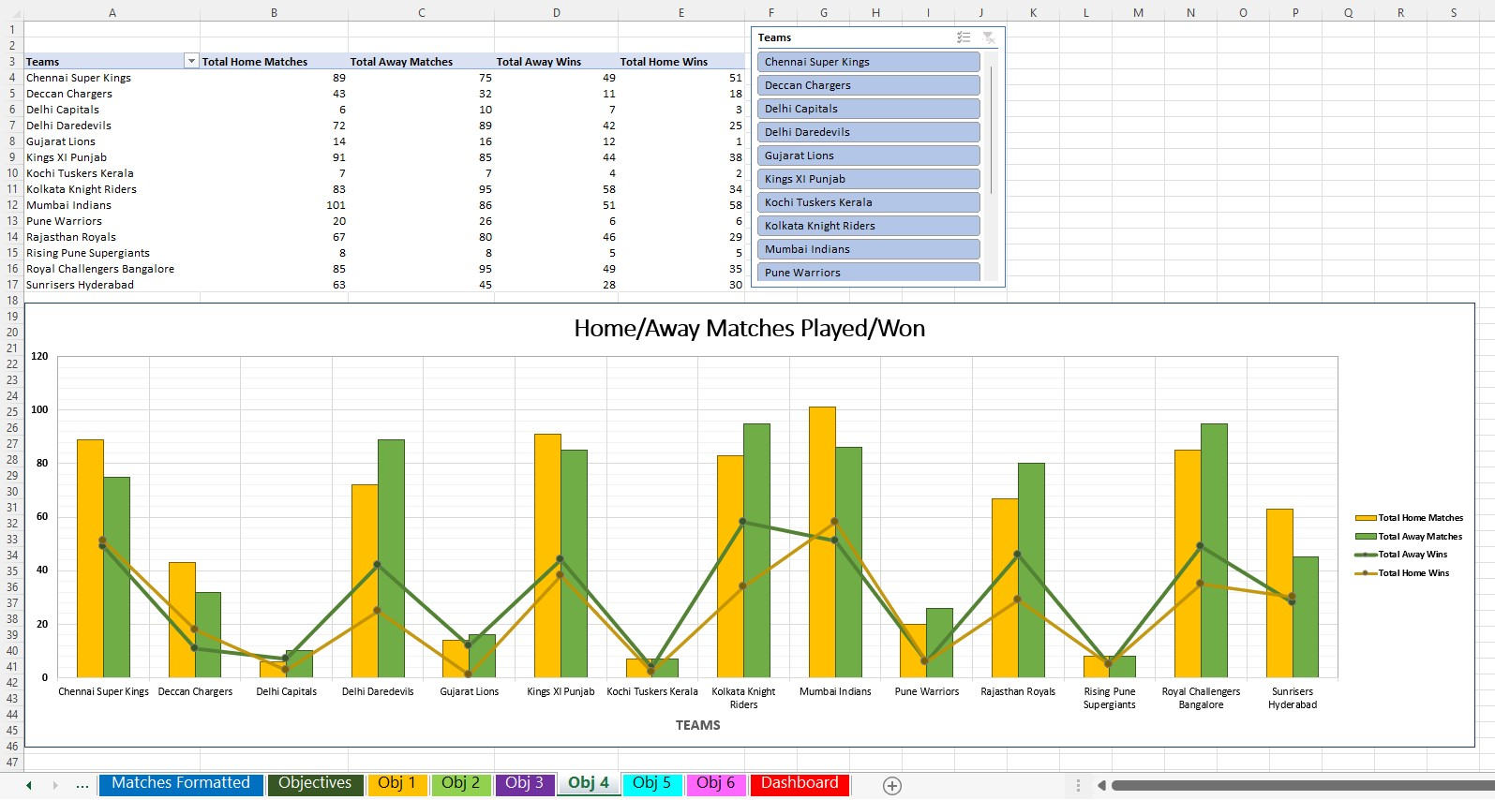
OBJECTIVE 4: Analyze the Home and Away - Matches played and Matches won.

Slide 13
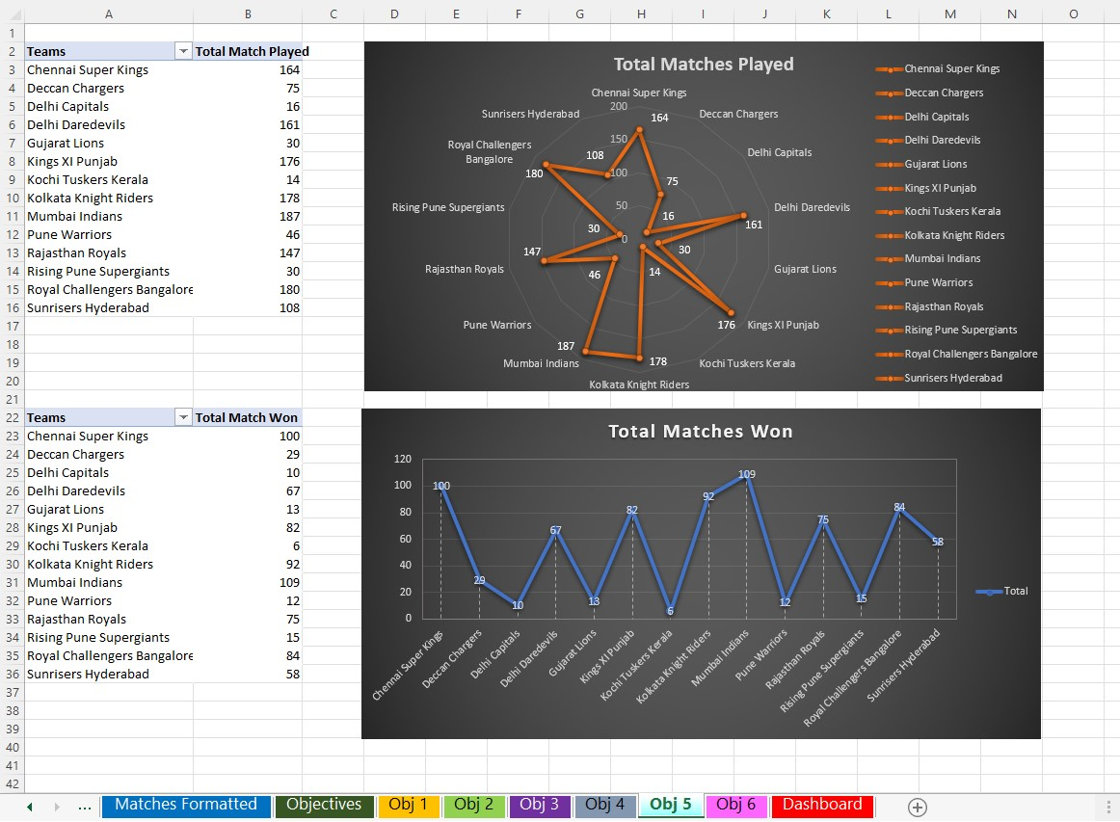
OBJECTIVE 5: Total Matches Played and Won by each team.

Slide 14
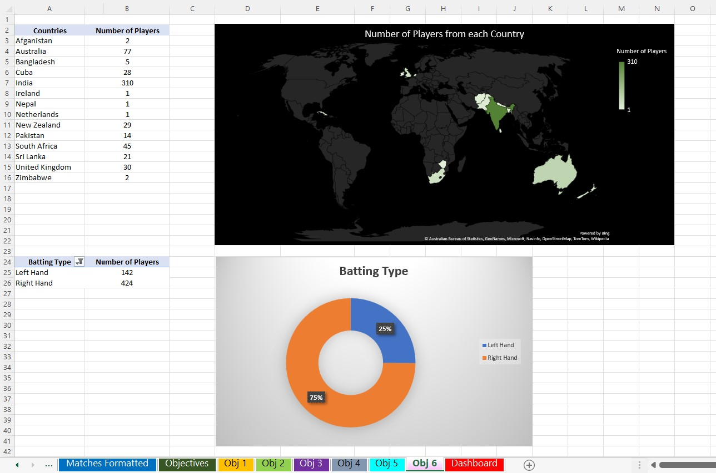
OBJECTIVE 6: Analyze Players on basis of their Country and Batting Type.

Slide 15
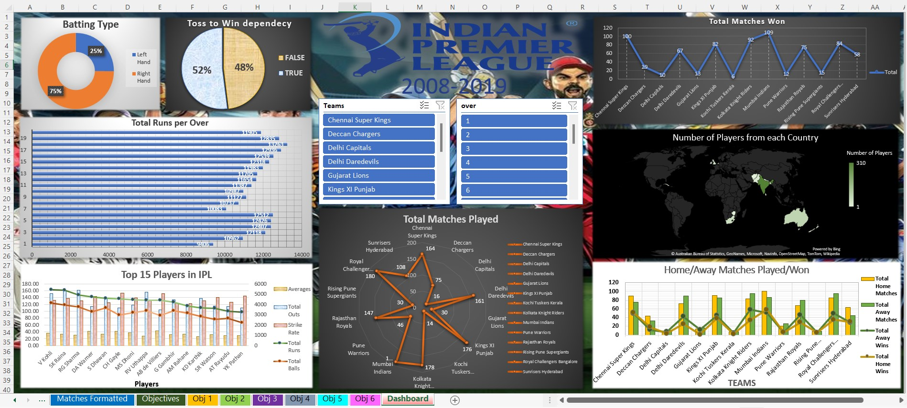
DASHBOARD

Slide 16
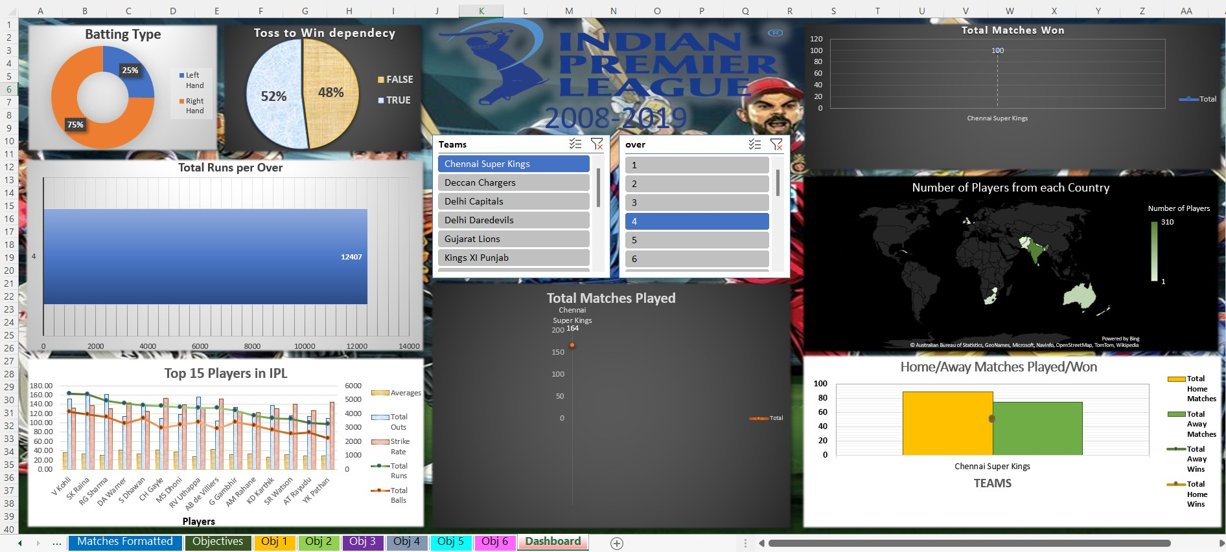
SLICERS
Using Slicers: - We can get filtered data that we want using slicers on the dashboard. For Example, select a Team “Chennai Super Kings” and select over number “4”. So, data of “Chennai Super Kings” is shown for Home and Away – Matches and won, Matches Played and Matches. And Total runs scored in “4th” over is displayed.

Slide 17

CONCLUSION
This project was valuable and rewarding. I have gained some useful insights about data analysis and representation in MS Excel.
I was able to conclude some insights from IPL dataset .
I used ETL process make proper use of the dataset by cleaning and organizing it.
It helped to develop data management and analytic skills. I also gained knowledge of the scope of using MS Excel its formulas and features and practically applying them to analyze information from a dataset.
I used a dashboard for representing all the analyzed information and used slicers to filter the data get personalized extracted information from the dataset. The dashboard offered a common, user friendly and interactive stage to present the data.
I got hands-on experience on a lot of the data management and analysis techniques and skills on the MS Excel software. I explored workbooks, worksheets, formulas, features like, Pivot tables, charts, etc.

Slide 18
THANK YOU

